Slide 1
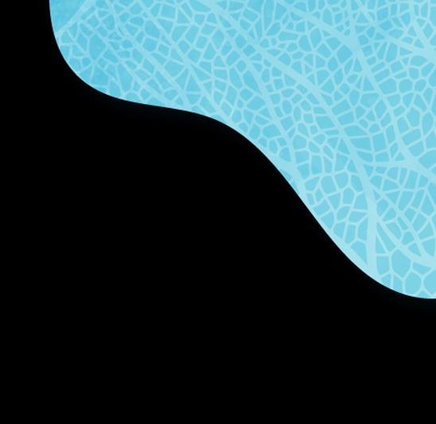

Policy Package for more sustainable and resilient fisheries, aquaculture and marine ecosystems

Slide 2

What is in the Package?
Common Fisheries Policy Communication: Implementation of the CFP and launching a Fisheries and Oceans Pact
Marine Action Plan: Protecting and restoring marine ecosystems
Energy Transition Initiative: Promoting and accelerating the energy transition in fisheries and aquaculture
Common Market Organisation Report: Implementation of the CMO Regulation

Slide 3


Communication on the Common Fisheries Policy
The CFP was reformed in 2013
There is no need for a new reform. All tools to address the current challenges are available in the existing legislative framework
What is needed?
→ A swifter and better implementation based on cooperation between all parties

Slide 4



Fisheries and Oceans Pact: a vision towards the future
Objectives:
Improve CPF implementation in the short term
Reinforce dialogue and mutual understanding, joining forces to prepare for future work

Slide 5



Marine Action Plan
Protecting and restoring marine ecosystems for sustainable and resilient fisheries:
Improve gear selectivity & address bycatch of sensitive species
Protect the seabed
Transition & knowledge
Governance

Slide 6

Energy Transition Initiative
A boost for the energy transition of the fisheries and aquaculture sector by supporting:
  the uptake of energy efficiency investments in the short to medium-term
  further developing and adopting additional renewable and low-carbon energy sources in the medium to long-term

Slide 7




4 areas to accelerate energy transition
Improve the governance framework and coordination/cooperation between stakeholders
Close the gaps in available technology and knowledge through R&I
Improve the business environment, including financing opportunities and awareness
Develop skills and a workforce prepared and ready for the energy transition
Energy Transition Partnership

Slide 8
Key messages from the CMO report
The reformed market policy effectively helps achieve the CFP objectives: competitiveness, market stability, transparency and ensuring a diverse supply of seafood to consumers.
Professional organisations, in particular Producer Organisations, are instrumental in improving market conditions for fisheries and aquaculture producers.
The CMO increased competitiveness through common legislative framework governed by the same marketing standards.
The CMO also set standards for market intelligence supporting policymaking and operators’ strategies, in particular in times of crises.

Slide 10
EU Missions:
A new way to bring concrete solutions to some of our greatest challenges.
Our Mission? The restoration of our ocean and waters.
Why a Mission? It tackles the problem on a European scale.
Deliver impact :
  New role for R&I
  Portfolio of actions
  New forms of governance & collaboration
  Citizens’ participation

Slide 11
Mission "Restore our Ocean and Waters"
- objectives and targets
Protect and restore marine and freshwaters ecosystems and biodiversity
Protect at least 30% and strictly protect 10% EU’s sea areas
Prevent and eliminate pollution of our oceans, Seas and waters
Make the blue economy carbon- neutral and circular
Net zero maritime emissions
Zero carbon aquaculture,
Reduce by at least 50% plastic litter
Restore 25.000 km free flowing rivers
Marine nature restoration targets (incl. degraded seabeds, coastal ecosystems)
Reduce by at least 30% microplastics
Reduce by at least 50% nutrient losses, chemical pesticides
Low carbon multipurpose use of marine space
  ENABLERS: - Digital Ocean and waters knowledge System
        - Public mobilization and engagement

Slide 12
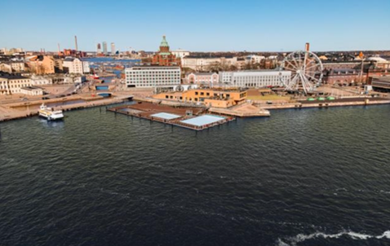
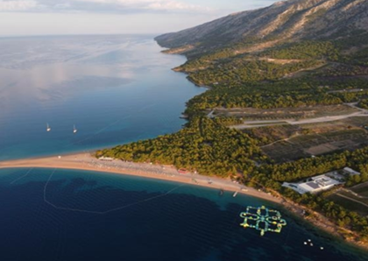
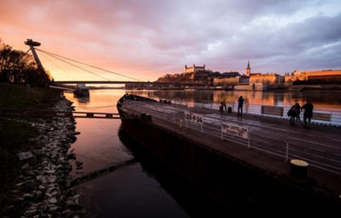
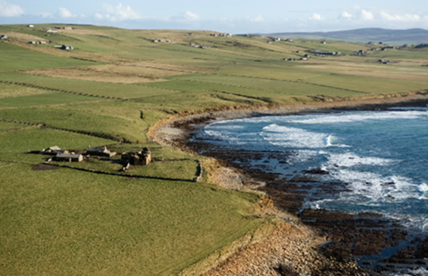

Ocean Mission lighthouses: sites to pilot, demonstrate, develop and deploy the Mission activities across EU seas and river basins
Baltic & North sea basin
Mediterranean sea basin
Prevent and eliminate pollution of our ocean, seas and waters
Make the blue economy carbon- neutral and circular
Danube river basin
Atlantic & Arctic coast
Protect and restore marine and freshwaters ecosystems and biodiversity
  https://www.youtube.com/watch?v=poZ7Dz4Xvl8

Slide 13
Horizon Europe - Mission Work Programmes/ Calls
CALL - EUR 114 million € for 20 selected projects
WP was adopted on 6 Dec 2022 - closing date: 20 Sept 2023
CALL - EUR 117.9 million € - selection on-going
2021
2022
2023

Slide 14
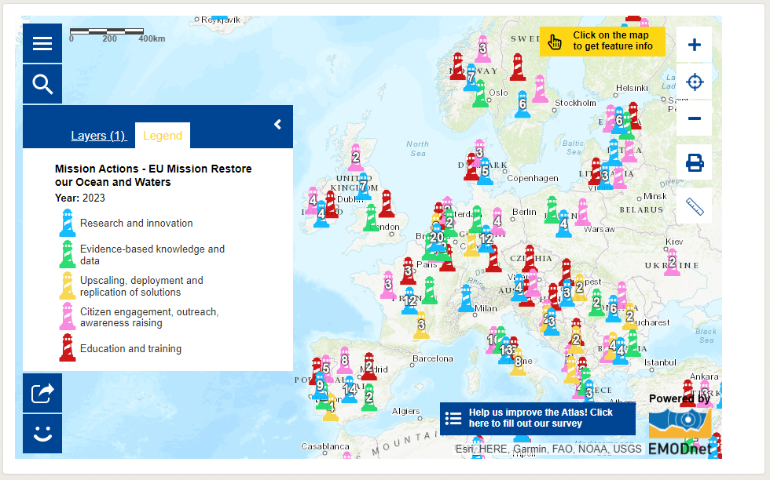
Mission Atlas presents the Charter actions
(available @ https://webgate.ec.europa.eu/maritimeforum/en/frontpage/1650)
To join, submit Mission Charter application via https://ec.europa.eu/eusurvey/runner/MissionOceanWatersCharter

Slide 15

Thank you
© European Union 2023
Unless otherwise noted the reuse of this presentation is authorised under the CC BY 4.0 license. For any use or reproduction of elements that are not owned by the EU, permission may need to be sought directly from the respective right holders.

